Slide 1

Name: Haw Eng Hong Student ID: 2290220 - BSE

Slide 2
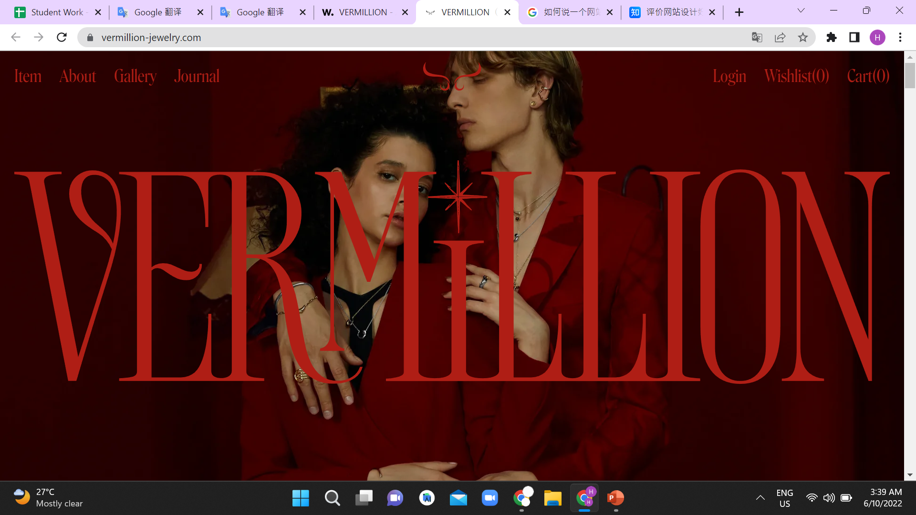
VERMILLION https://vermillion-jewelry.com/

Slide 3

Its Design Strengths
Have clear target
Very new design way for ecommerce
Has an outstanding design but not over

Slide 4
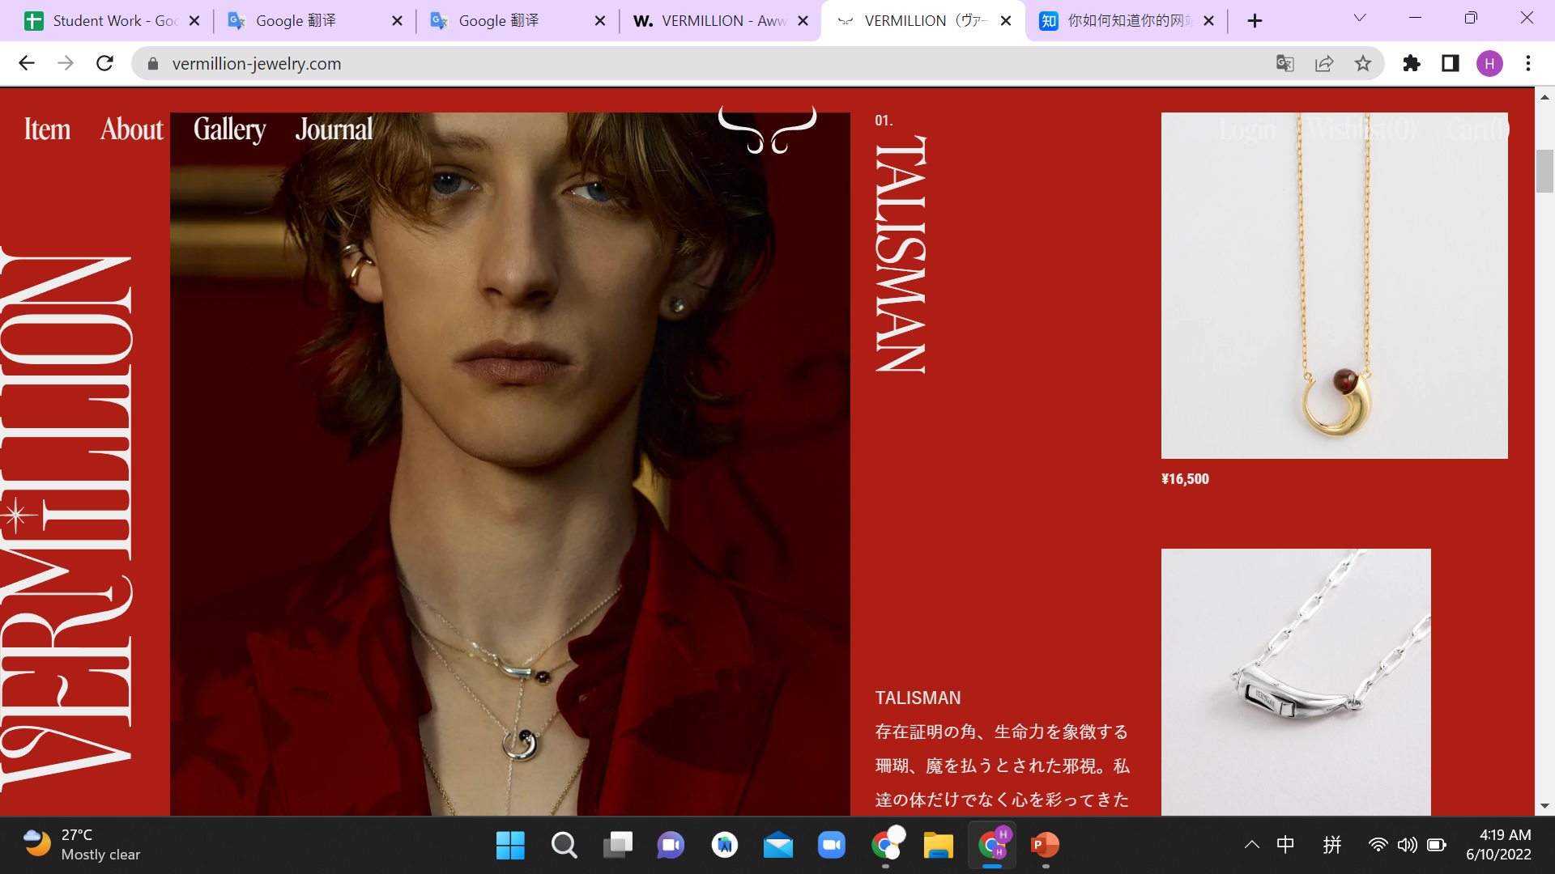
Have clear target

Slide 5
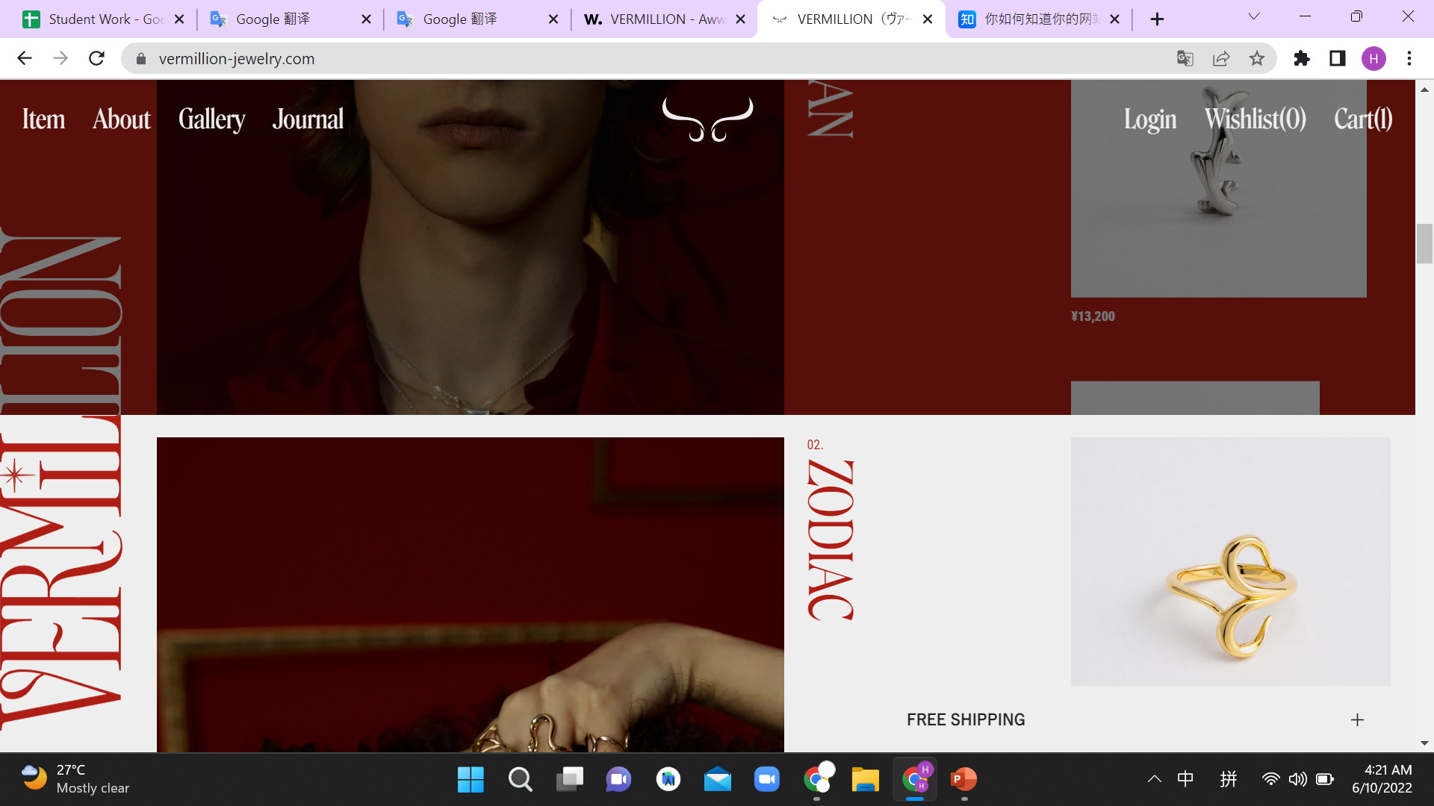
Very new design way for ecommerce

Slide 6
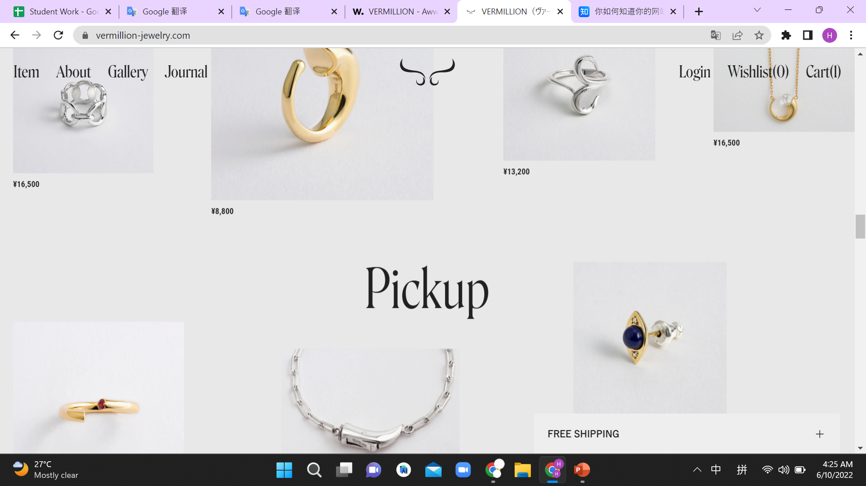
Has an outstanding design but not over

Slide 7

Its Design weaknesses
Visual display is too garish
Layout availability is low
Less commodity-centric

Slide 8
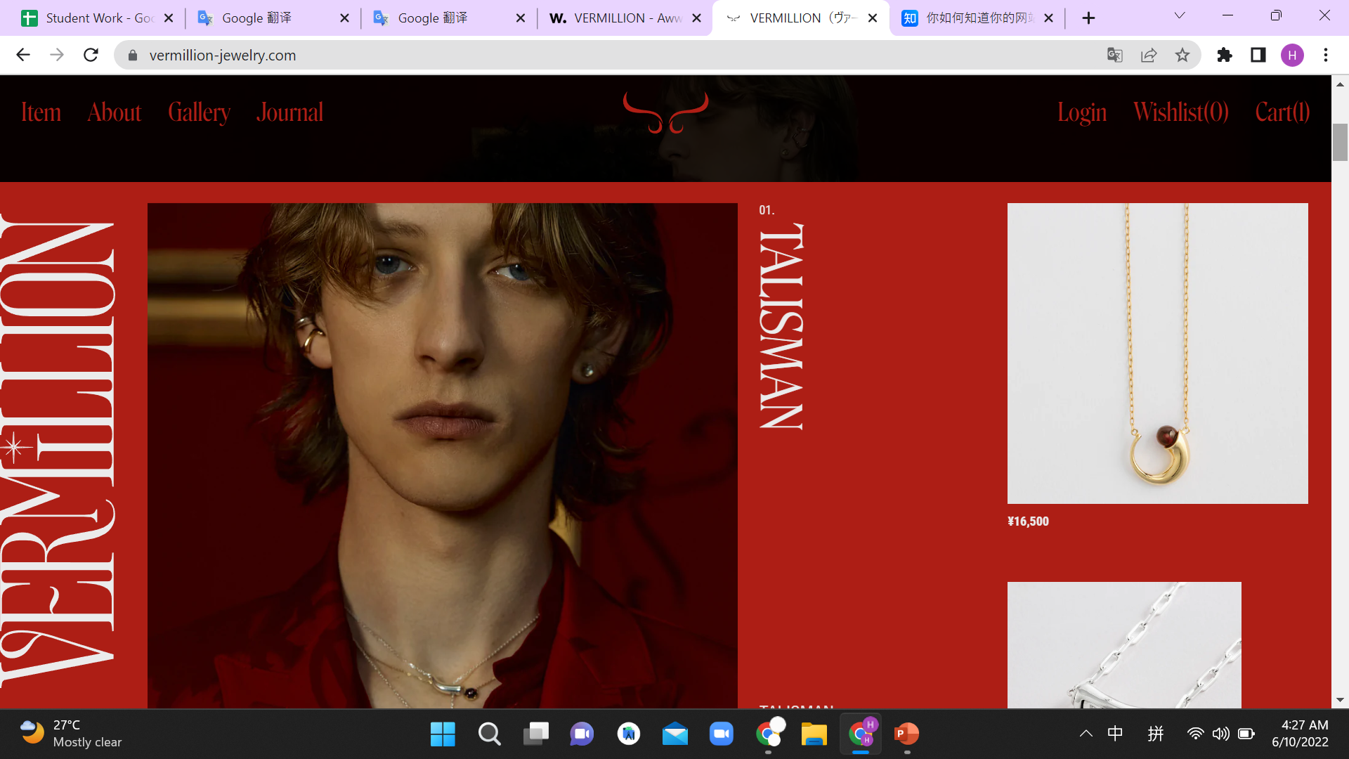
Visual display is too garish

Slide 9
Layout availability is low

Slide 10
Less commodity-centric

Slide 11
Its Creativity Strengths
Have a good concept
Have a clear layout idea
have a sense of fashion

Slide 12


Slide 13
Its Creativity weaknesses
Don't have a clear product strategy
No clear target audience
There is not much creative thought on consumer

Slide 14
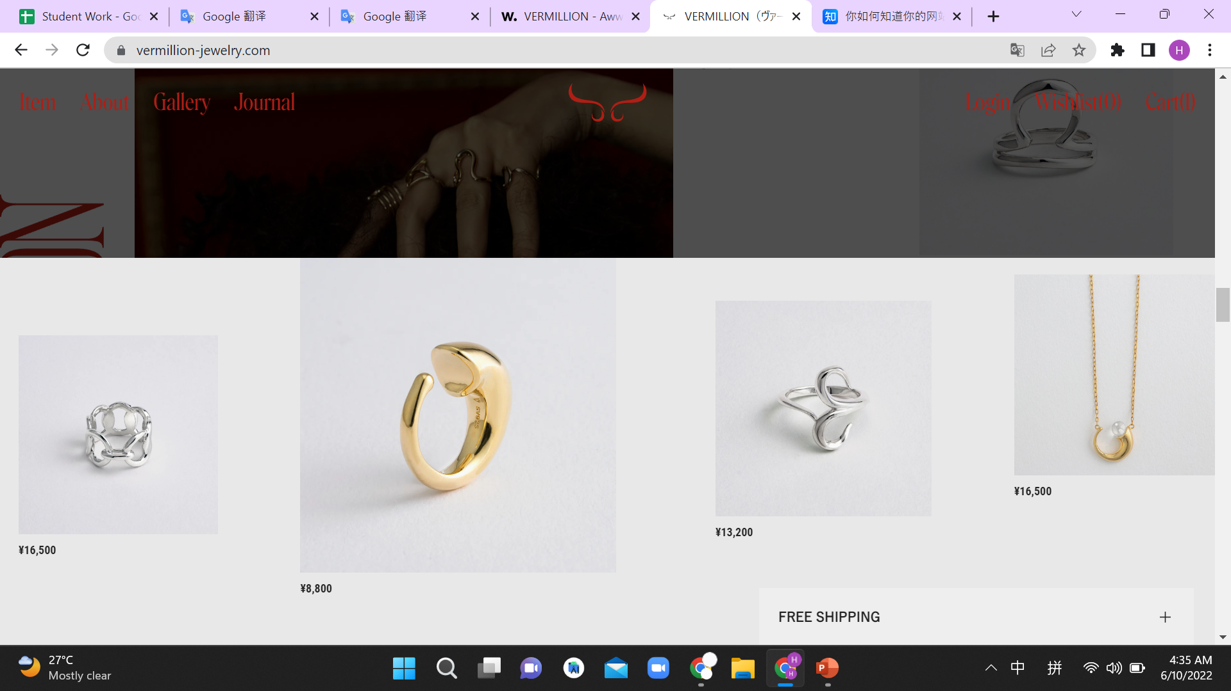

Slide 15

Its Usability Strengths
User-friendliness is very high
All functions (such as buttons, etc. can work)
Availability is very high

Slide 16

Its Usability weaknesses
doesn't have a search bar, its utility is rather limited
The layout on the phone will change
Don’t have side bar

Slide 17
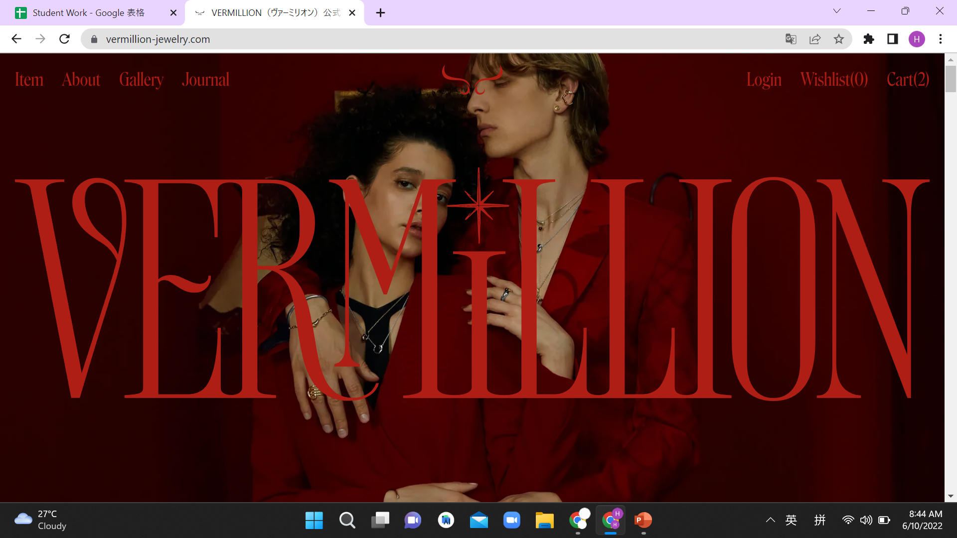

Slide 18
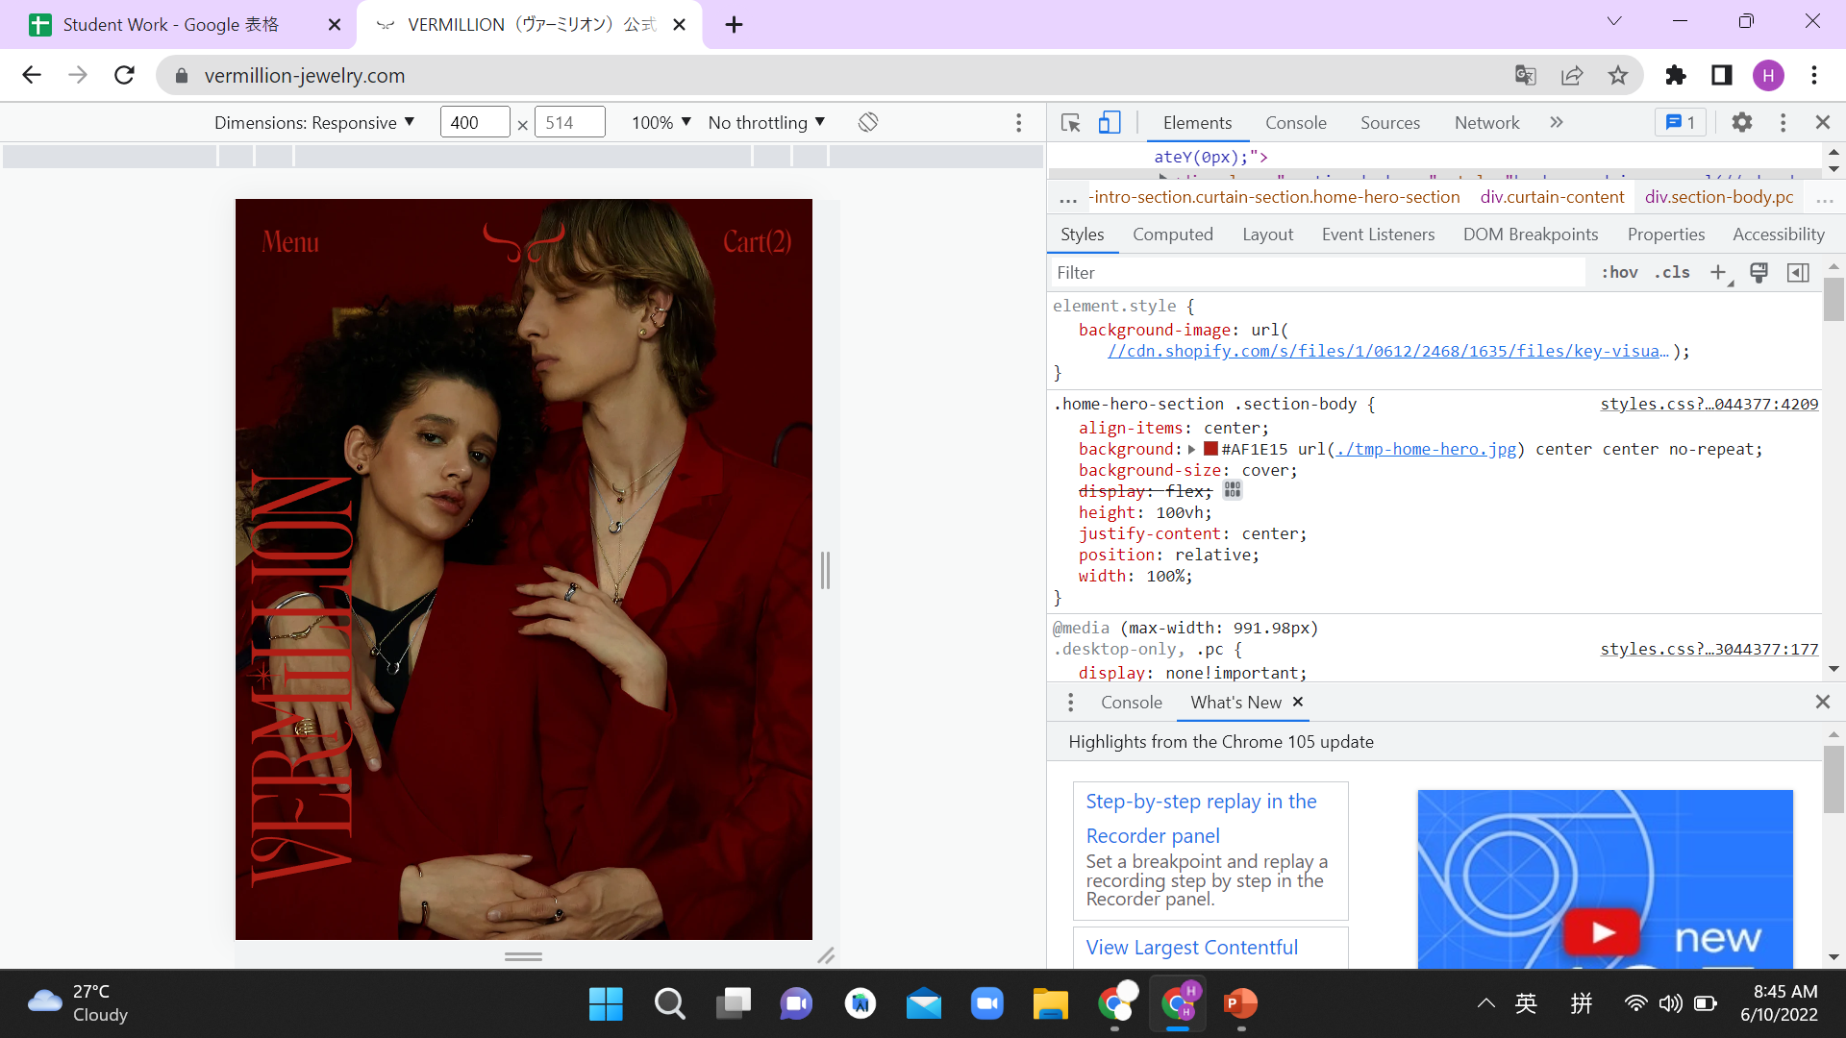
The layout on the phone will change

Slide 19

Its Content Strengths
The quality of the content is very high
Because it is a blank design, it brings a better sense of reading
The color of the content is consistent with the theme and does not make it difficult to read.

Slide 20
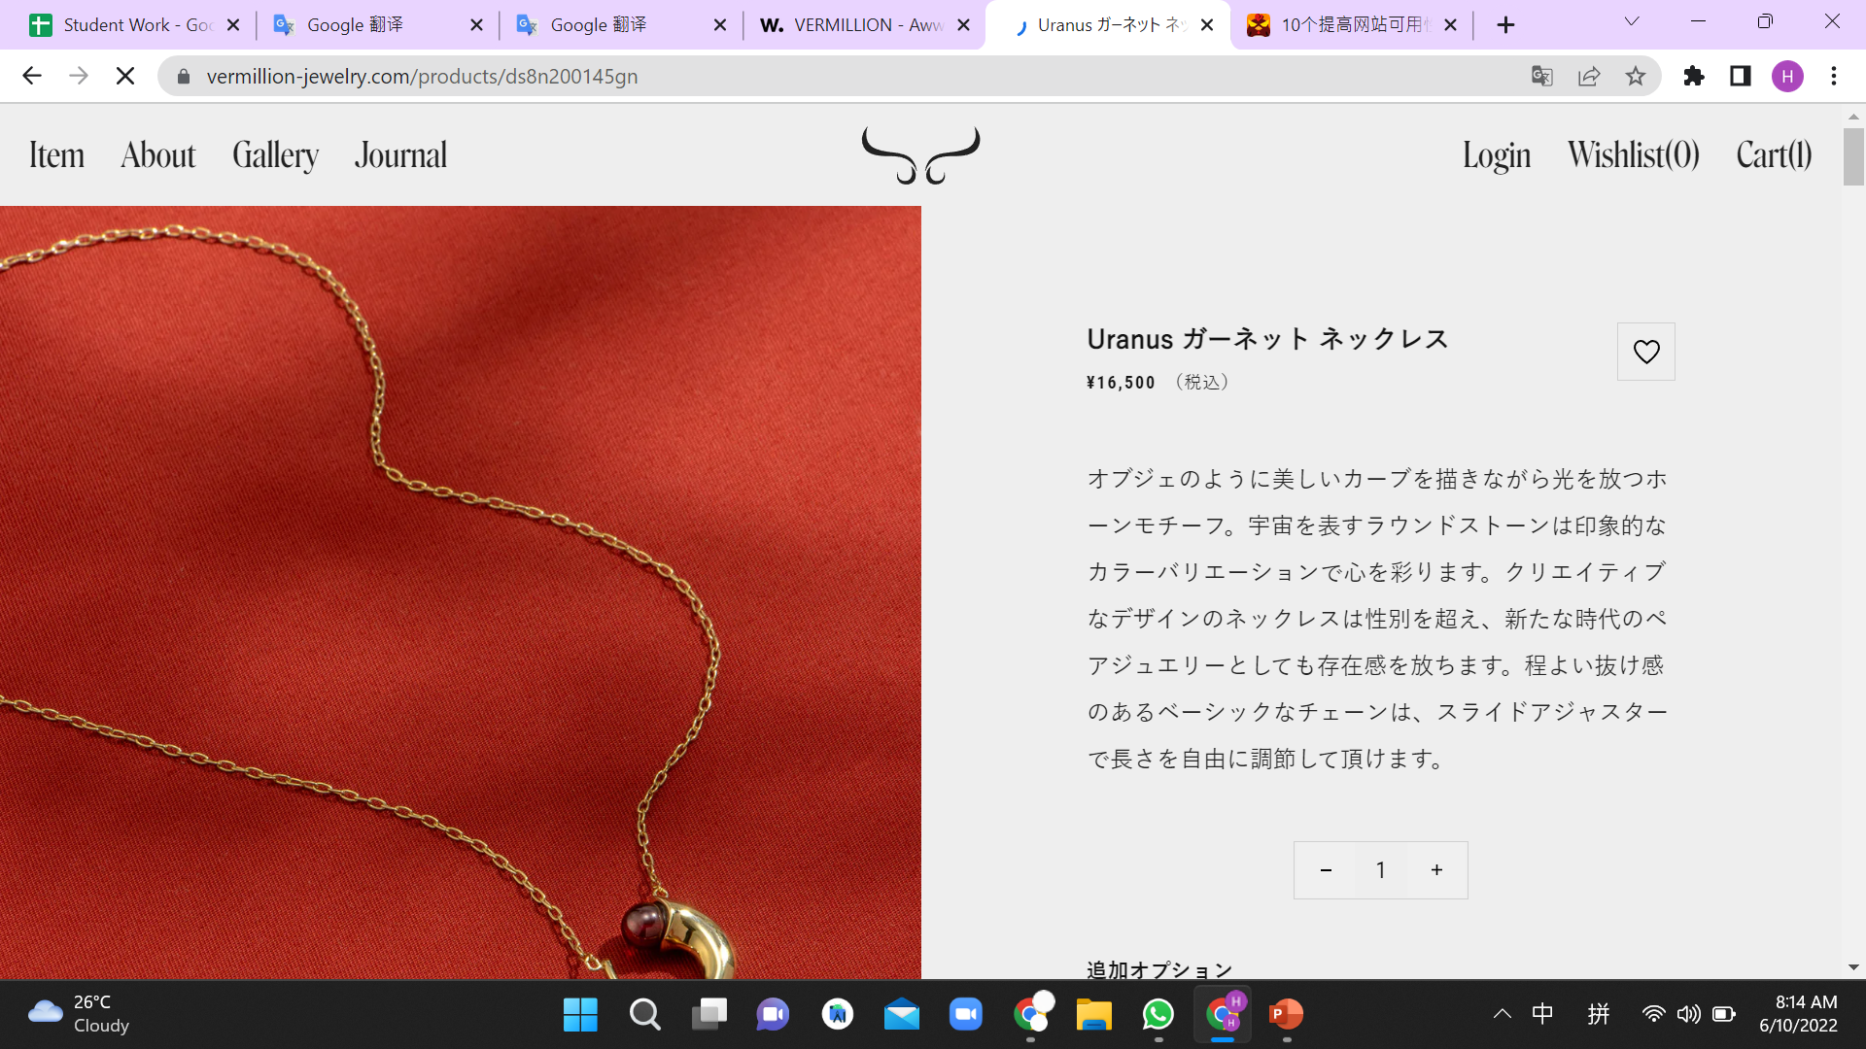

Slide 21
Its Content weaknesses
Only Japanese language
Lack of some introduction to the brand
Too few social media options to browse

Slide 23
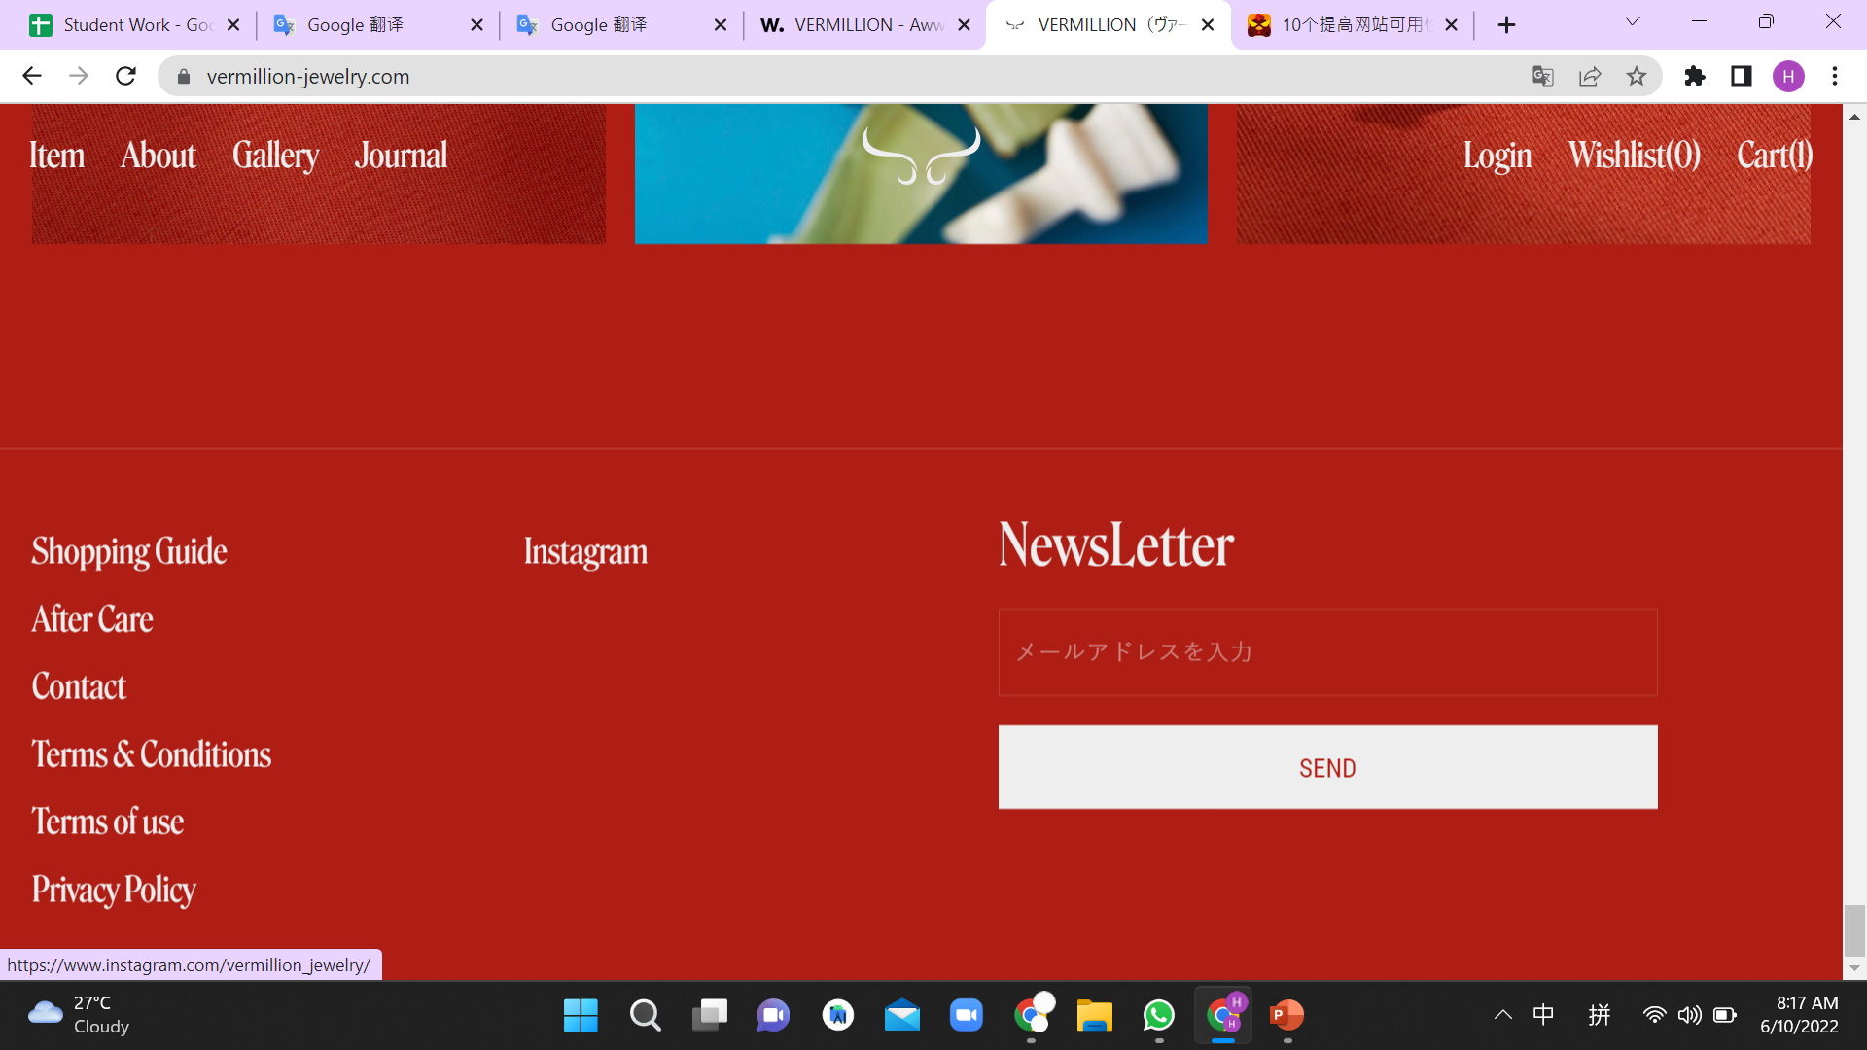
Too few social media options to browse

Slide 24

Thank You !

